Slide 1
Cell segmentation / classification
On microscopic images using deep learning

Slide 2
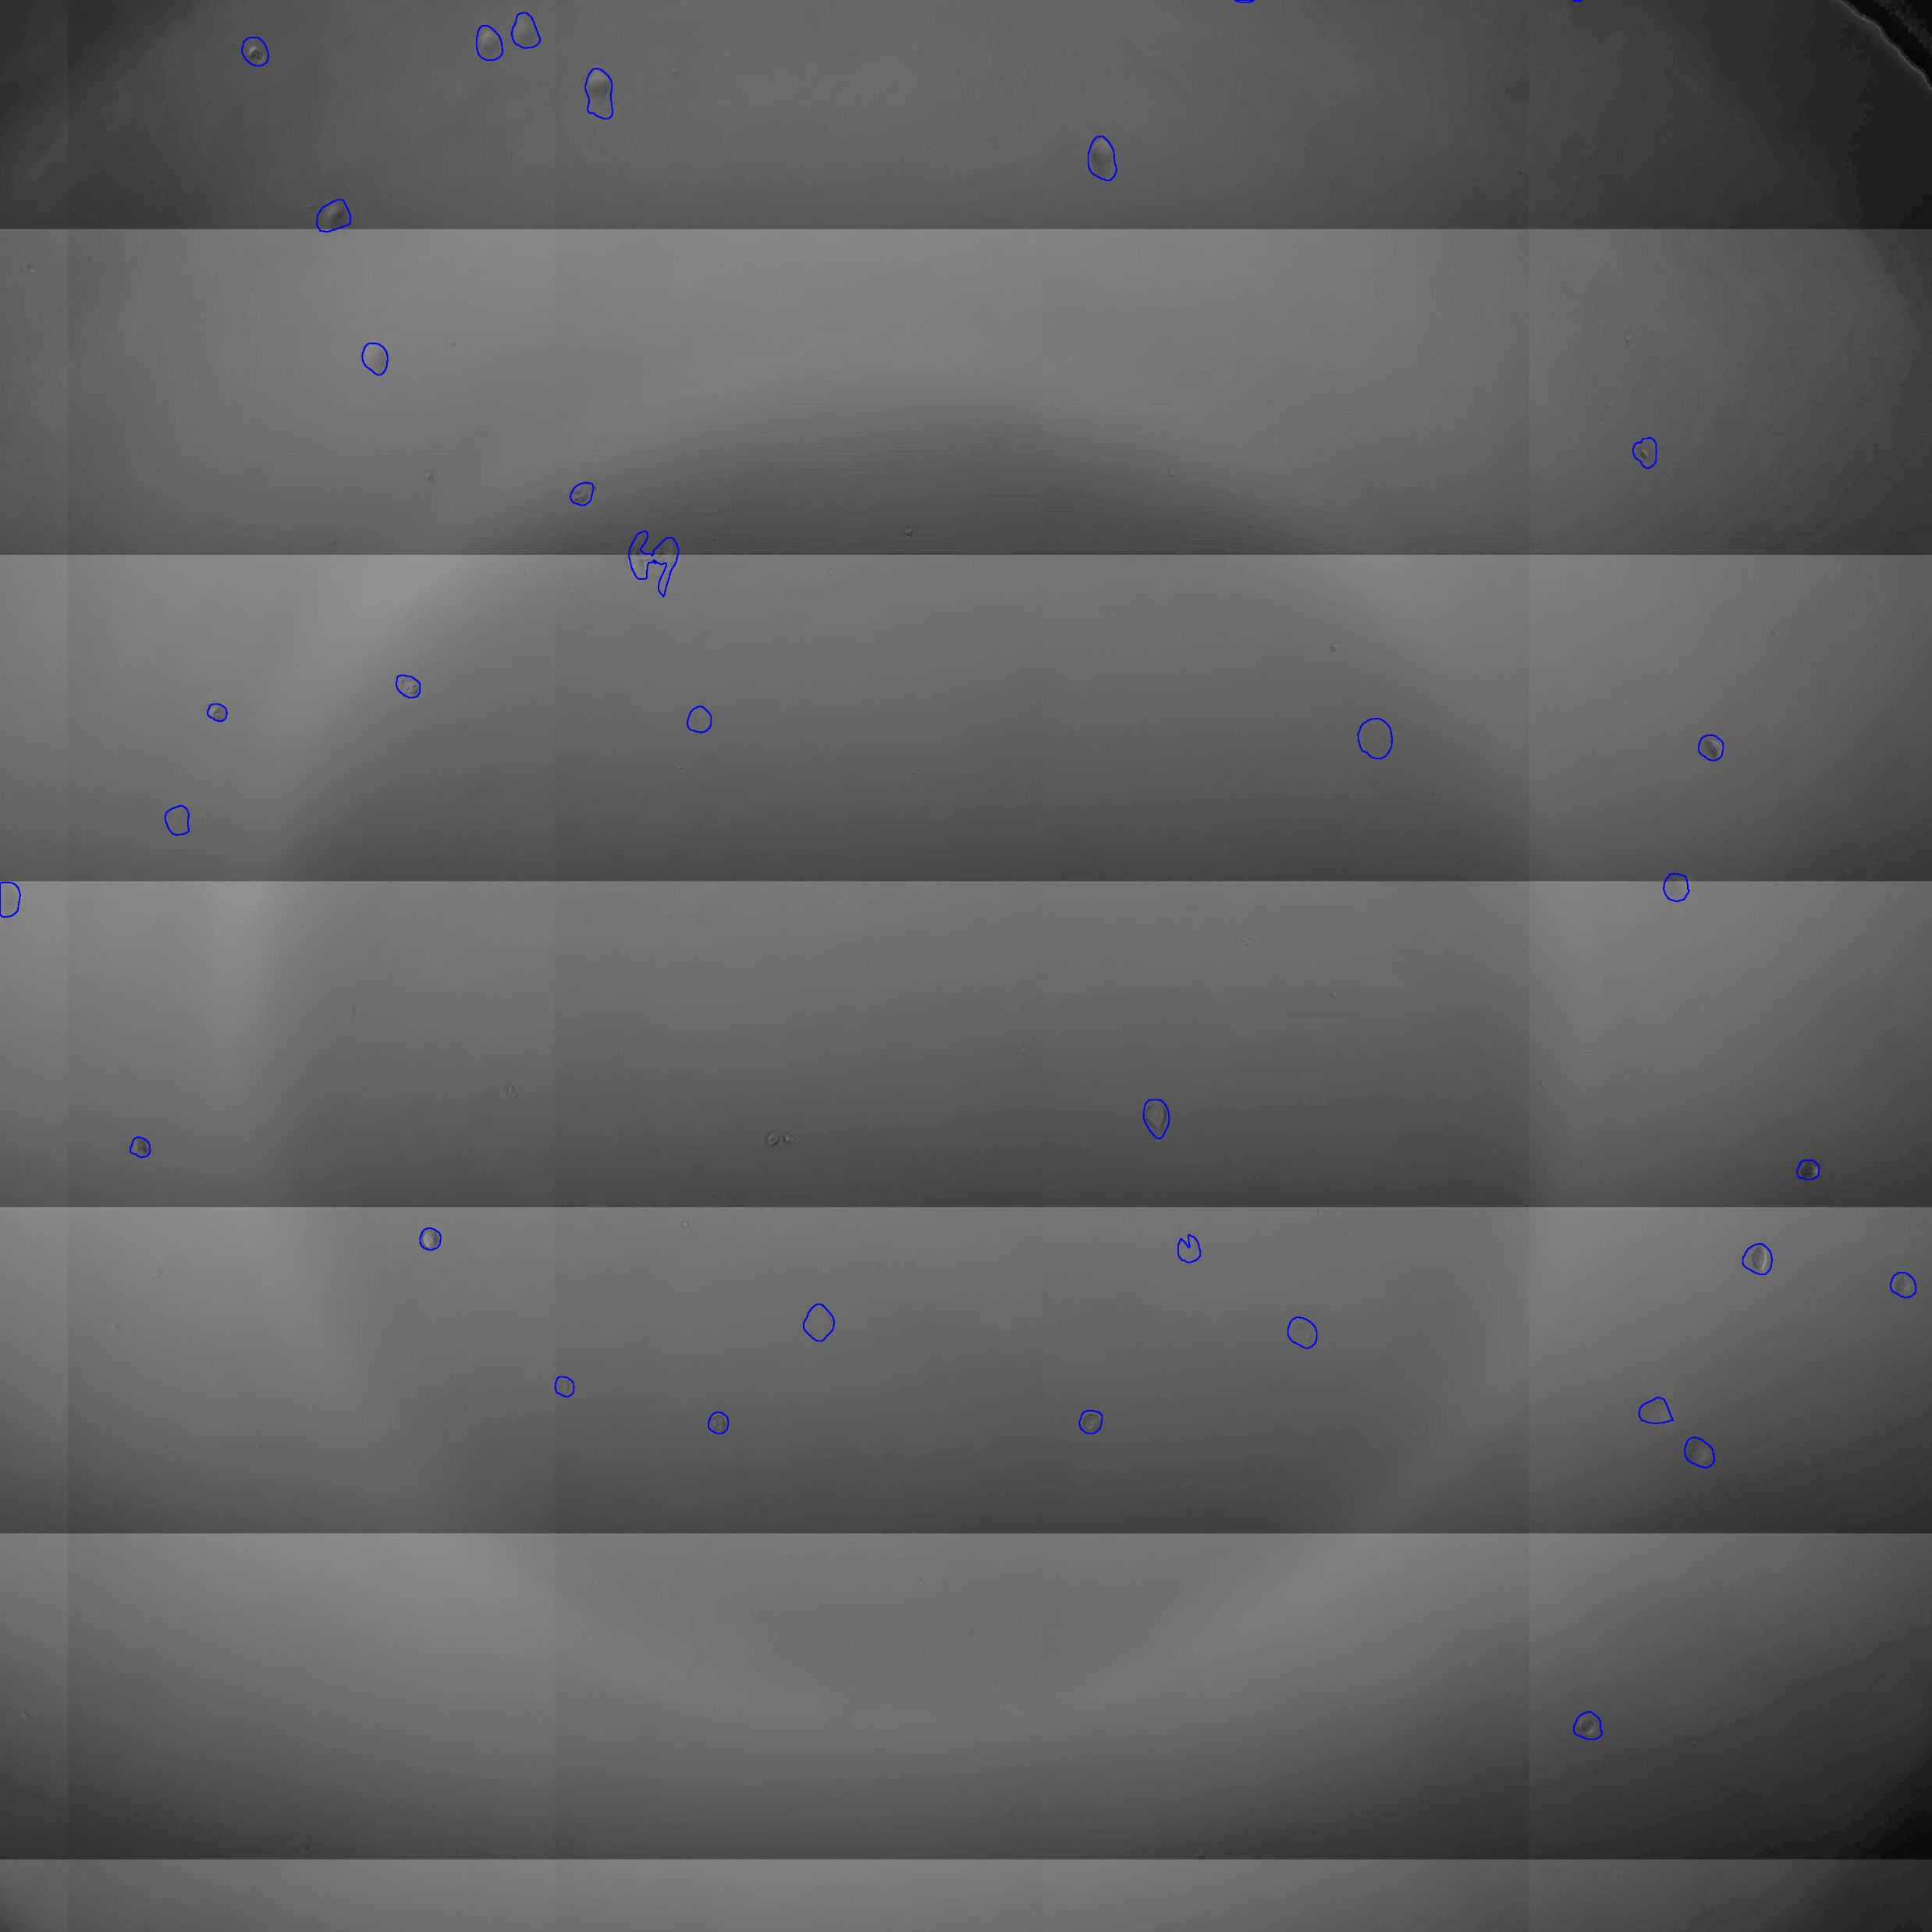
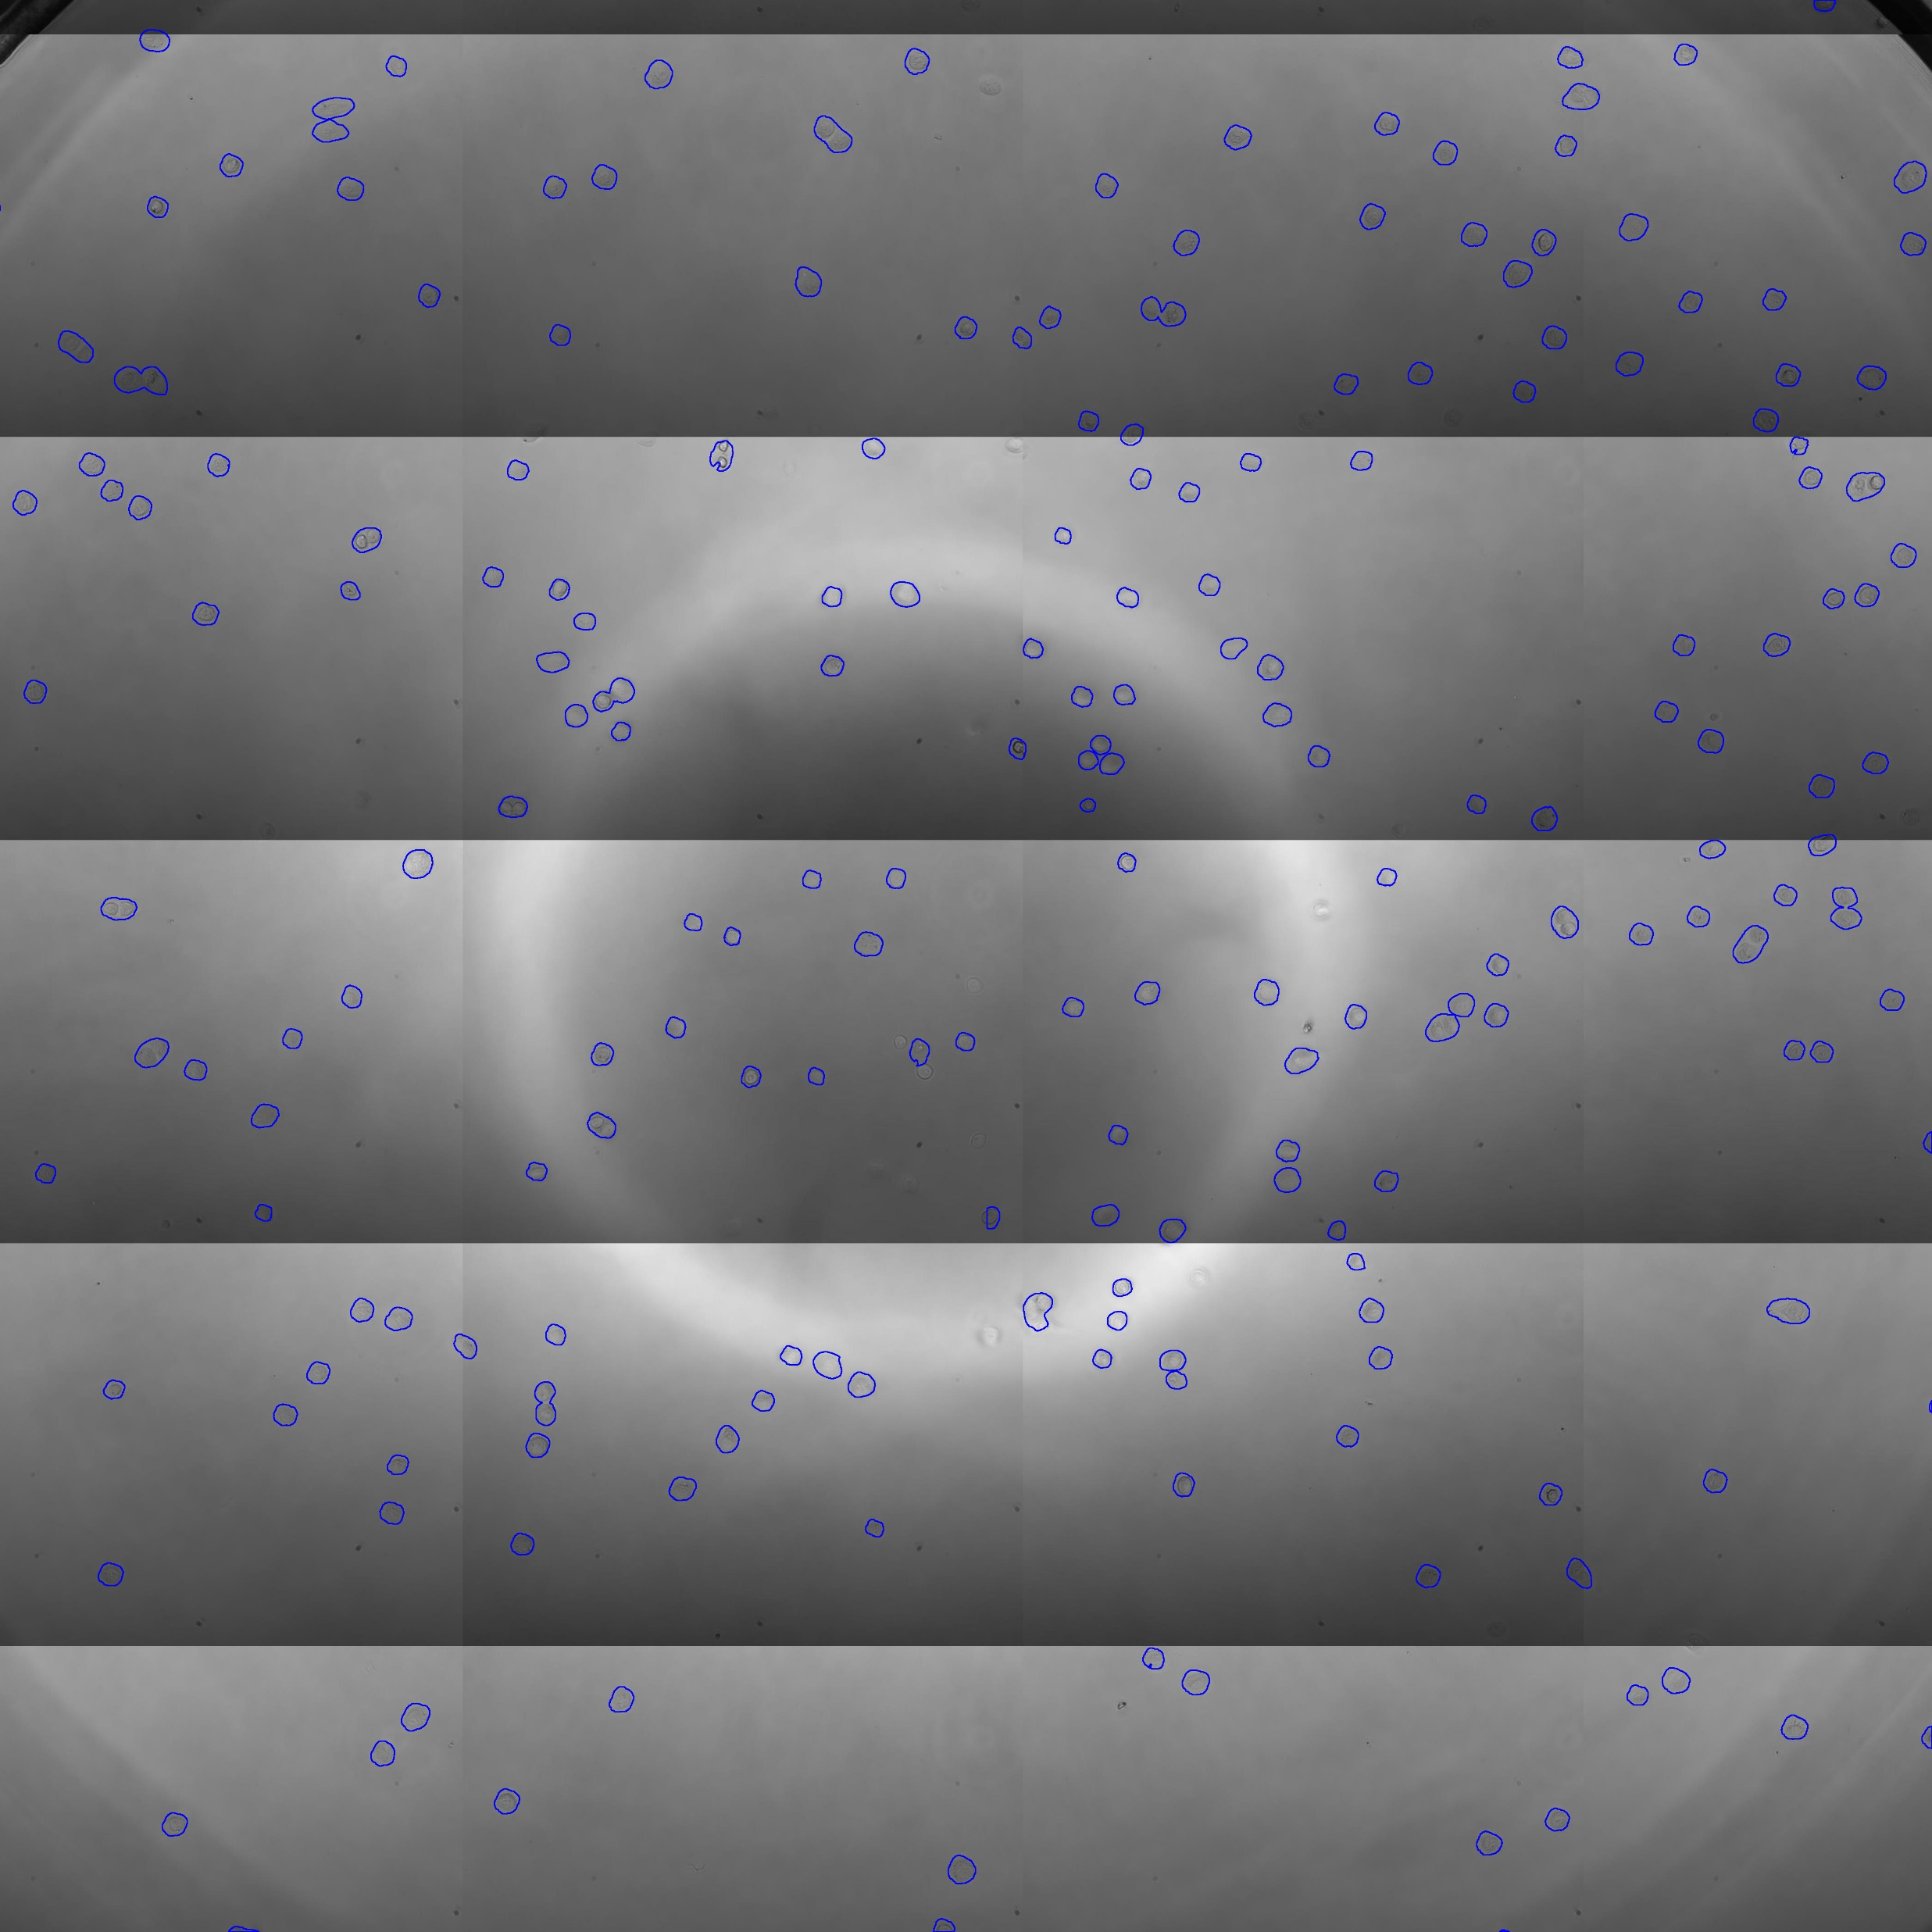
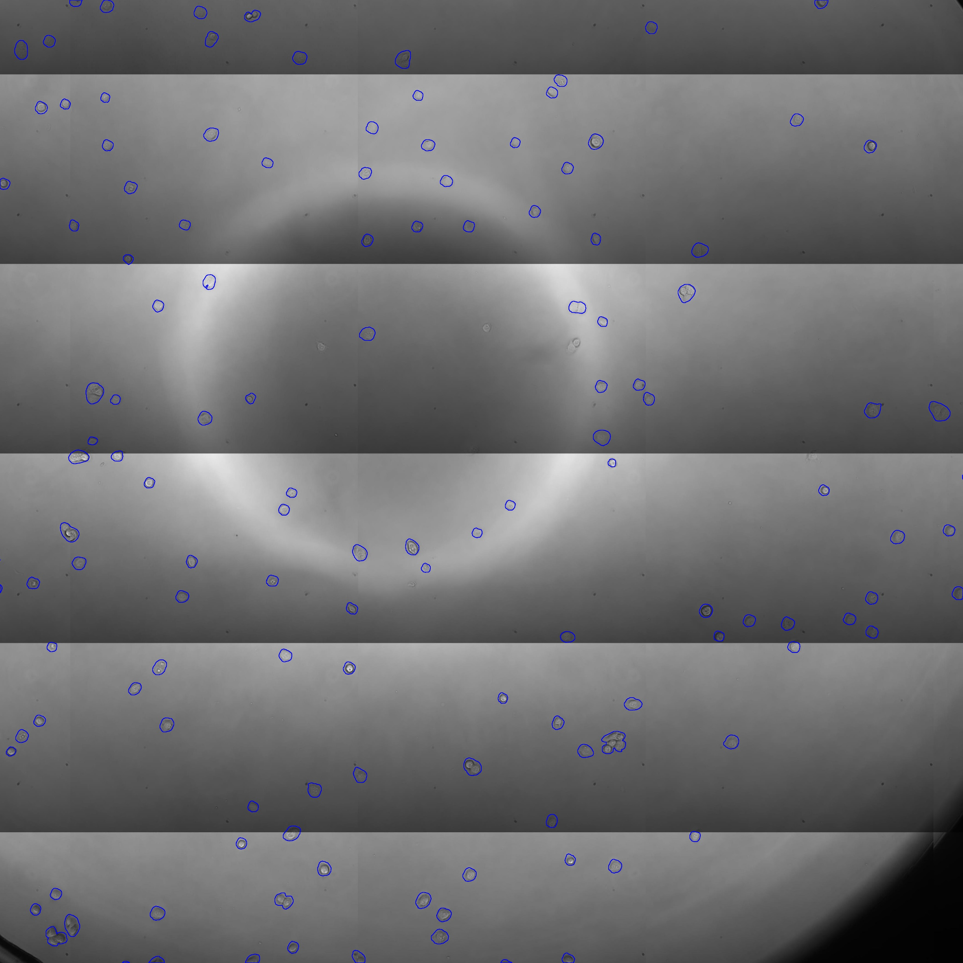
Dataset
Annotated images from phase-contrast microscopic and fluorescent sources.

Slide 3
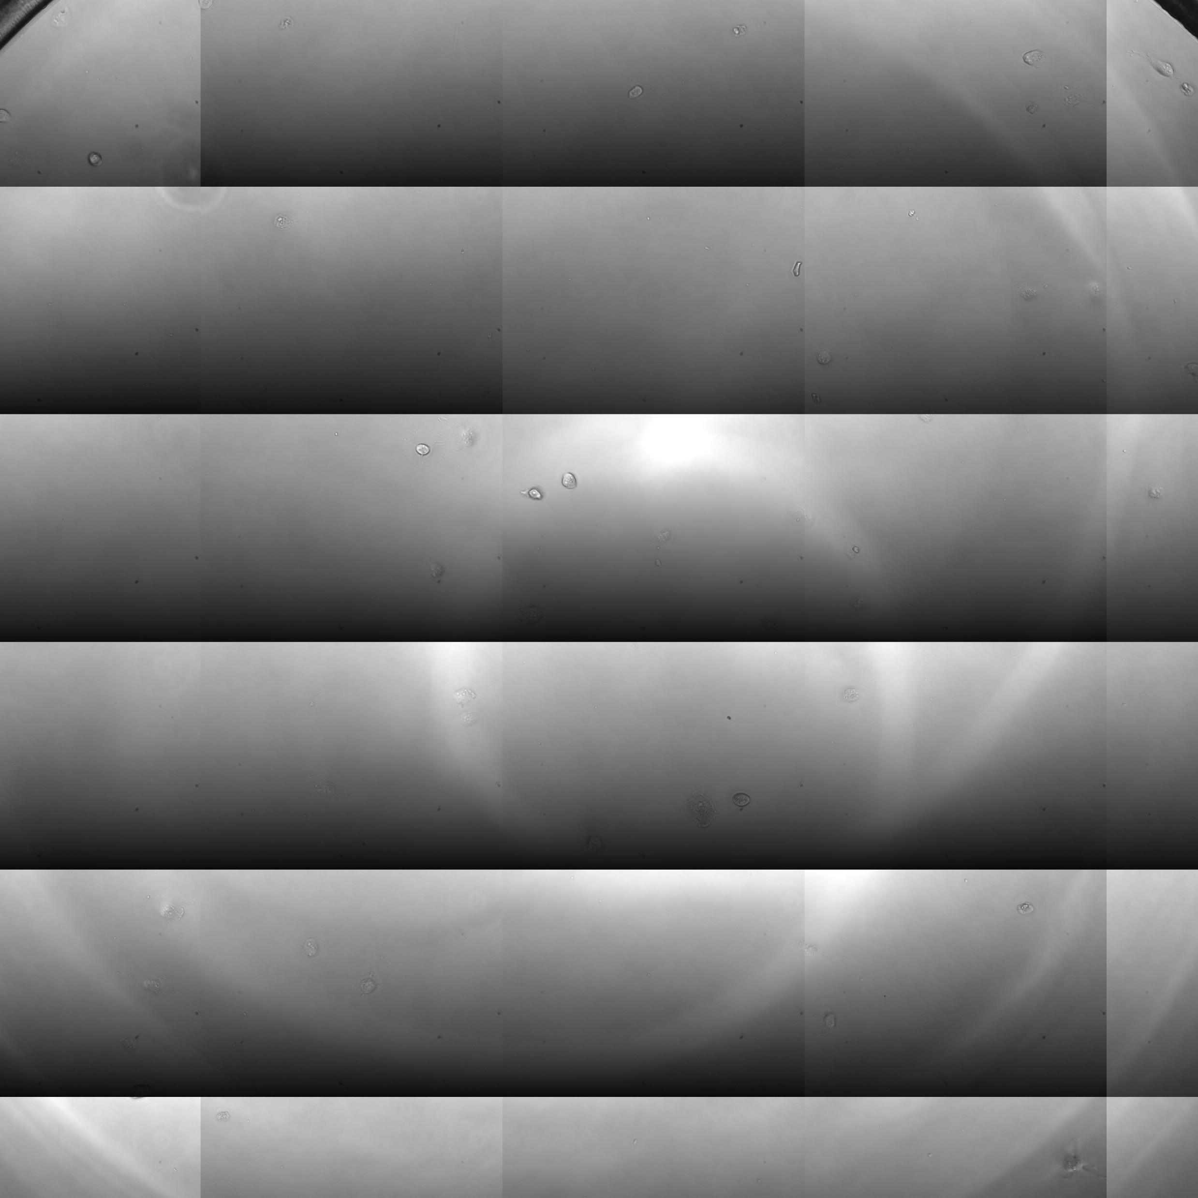
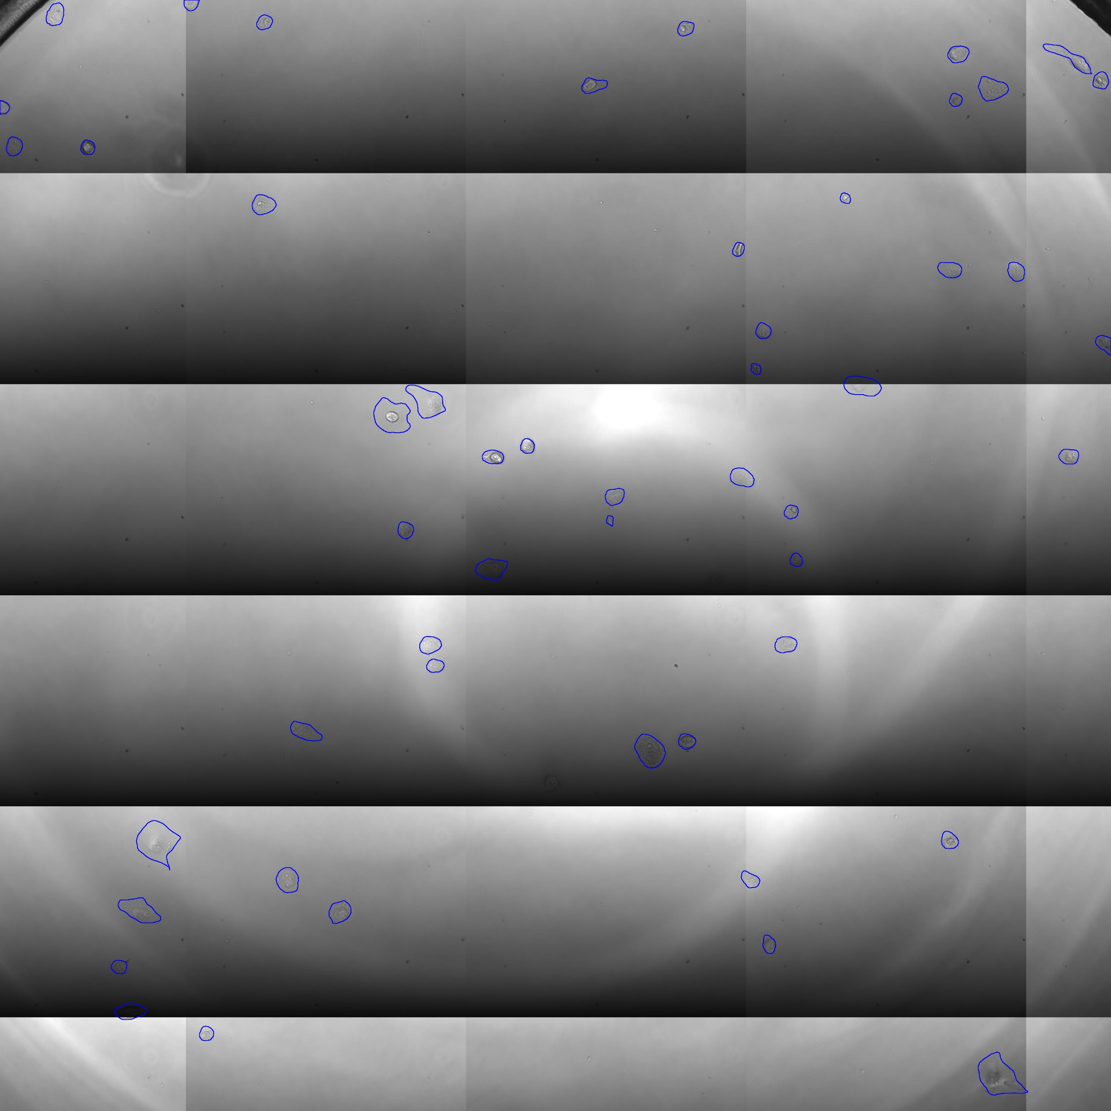


Goal
Classification model
Cell line
Cellpose model
. . .
Classification model
Cell line

Slide 4
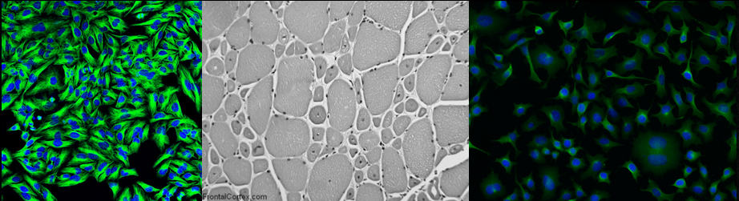
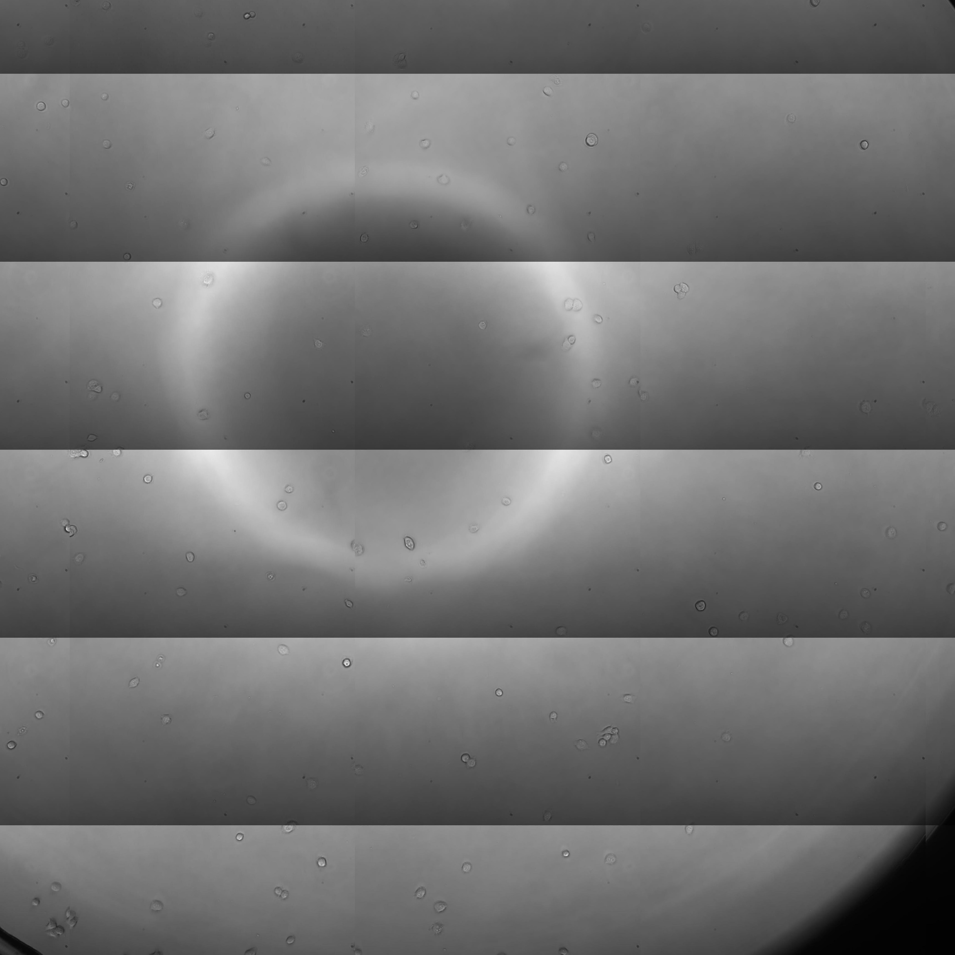

Segmentation model
Global segmentation capability is needed.
Using diverse set of cell lines for training.
Set of examples is small.
Fine-tuning a pre-trained model for better accuracy.
Using cyto3 cellpose model.
+
Cellpose dataset (big)
Our dataset (small)
https://www.cellpose.org/

Slide 5

Classification model
Using convolutional neural network architecture.
Predicts a probability distribution of possible cell lines.
Supervision is needed.
Did the model generalize?
Or did it just learn the specifics of the measurement methodology?
https://www.mdpi.com/1099-4300/19/6/242

